Slide 1
Maximum Power Point Tracking (MPPT)
A way of extracting maximum power from solar panels under all conditions.
Solar panels are easily affected by changes in temperature and operating conditions that they produce a non-linear and impure output.
MPPT system is used to sample the output of the PV cells and apply the proper resistance (load) to obtain maximum power for any given environmental conditions.
The major principle of MPPT is to extract the maximum available power from PV module by making them operate at the most efficient voltage (maximum power point).
MPPT checks output of solar panels module, compares it to battery voltage then fixes what is the best power that panel can produce to charge the battery and converts it to the best voltage to get maximum current into battery. It can also supply power to a DC load, which is connected directly to the battery.

Slide 2
Maximum Power Point Tracking (MPPT)
The voltage–current (V–I) and power–voltage (P–V) characteristics of a solar panel are non-linear.
For each condition, there is one operating point where the product of voltage and current (power) is maximum — called the Maximum Power Point (MPP).
Without MPPT, the PV system may operate away from this point, leading to power loss.
Steps:
The MPPT controller continuously measures PV voltage (V_{PV}) and current (I_{PV}) and power is calculated as: P=V_{PV}×I3=_{PV}.
The controller compares the present power with previous values to determine whether it is moving towards or away from the MPP.
MPPT controls the duty cycle of a DC–DC converter (Buck, Boost, or Buck-Boost). This changes the input impedance seen by the PV panel. As a result, the operating voltage of the panel shifts toward the MPP.
Since sunlight and temperature change continuously, MPPT keeps tracking the MPP in real time.

Slide 3
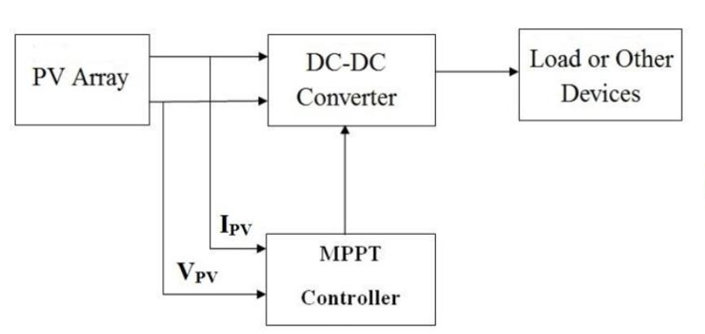
Maximum Power Point Tracking (MPPT)

Slide 4
MPPT
MPPT is most effective under these conditions:
Cold weather, cloudy or hazy days: Normally, PV module works better at cold temperatures and MPPT is utilized to extract maximum power available from them.
When battery is deeply discharged: MPPT can extract more current and charge the battery if the state of charge in the battery is less.
MPPT devices are typically integrated into a systems that provides voltage or current conversion, filtering, and regulation for driving various loads, including power grids, batteries, or motors.
Inverters, solar controllers, solar panels, optimizers and DC-DC converters may incorporate MPPT

Slide 5
PV (solar) inverters are commonly classified by mode of operation, system configuration
By mode of operation
Stand‑alone (off‑grid) inverters: Supply AC to isolated loads from batteries/PV without any grid connection.​
Grid‑connected (grid‑tie) inverters: Inject power into the utility grid while synchronizing voltage, frequency, and phase.​
Bimodal / hybrid inverters: Can work both grid‑connected and stand‑alone (typically with battery storage), switching modes during outages.​
By system configuration / level
Central inverters: One large inverter for many parallel PV strings, typically used in large utility‑scale plants (tens of kW to multi‑MW).​
String inverters: One inverter per string or few strings, widely used in residential and commercial systems (hundreds of W to ~100 kW).​
Multi‑string inverters: Several independent strings each with its own DC/DC stage feeding a common DC/AC inverter, improving MPPT flexibility.​
Module / microinverters: One small inverter per module, performing MPPT at module level, suited to shading or complex roofs.​

Slide 6
DC to DC converter
A DC-to-DC converter or a voltage regulator is a device or circuitry that converts a source of DC from one voltage level to another.
Most solar systems come with a special type of component that is able to convert DC to DC.
Solar panels generate DC to be converted to AC for use in appliances by an inverter.
A DC/DC Converter maybe installed per solar panel to help maximize the solar energy generated. A DC-DC converter can boost the total solar energy produced by up to 30%.
It measures the power and energy produced per module, as well as the temperature and voltage of the panel. They are able to shut down the panel's DC voltage when the temperature or voltage is too high.
They operate by taking DC input from the solar panel, changing it to AC and converting it back to a different DC voltage and current to exactly match the solar panel to the battery or inverter.

Slide 7
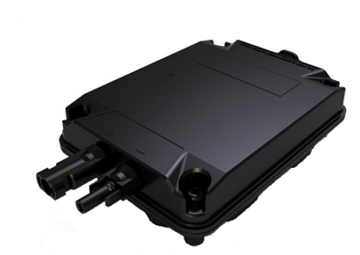
Examples of dc to dc converters
Examples of DC to DC converter are
Boost converter is power converter in which the panel DC input voltage is less than DC output voltage. That means the solar panel input voltage is less than the battery voltage in system.
Buck converter is power converter which DC input voltage is greater than DC output voltage. That means the solar panel input voltage is greater than the battery voltage in system.
DC-DC converters are often installed at the back of a solar panel. They solve the impact of shading conditions, module mismatch, temperature variance and aging mismatch of panels.

